Slide 1


MOCK PROJECT
TEAM - MUKUL

Slide 2









PROBLEM STATEMENT
LUXURY HOTELS PARTNERING WITH BED AND BREAKFASTS

Slide 3






Meet Our Team
MUKUL JINDAL
TEAM LEAD
DEVANSH SINGH
DESIGN CO-HEAD
PRIYAL GOENKA
CONTENT HEAD
ARYAN TAWDE
Bussiness ANALYST
ANUBHAV JAGNANI
DESIGN CO-HEAD
SUYASH SINHA
MARKET ANALYST

Slide 4





01
Unique Charm of B&B
02
Partnership Assesment
03
Key Considerations
PRESENTATION
AGENDA
Role of The Hotel
04
05
Marketing and Branding
06
Framework and Guesstimate
Future Prospects
07

Slide 5
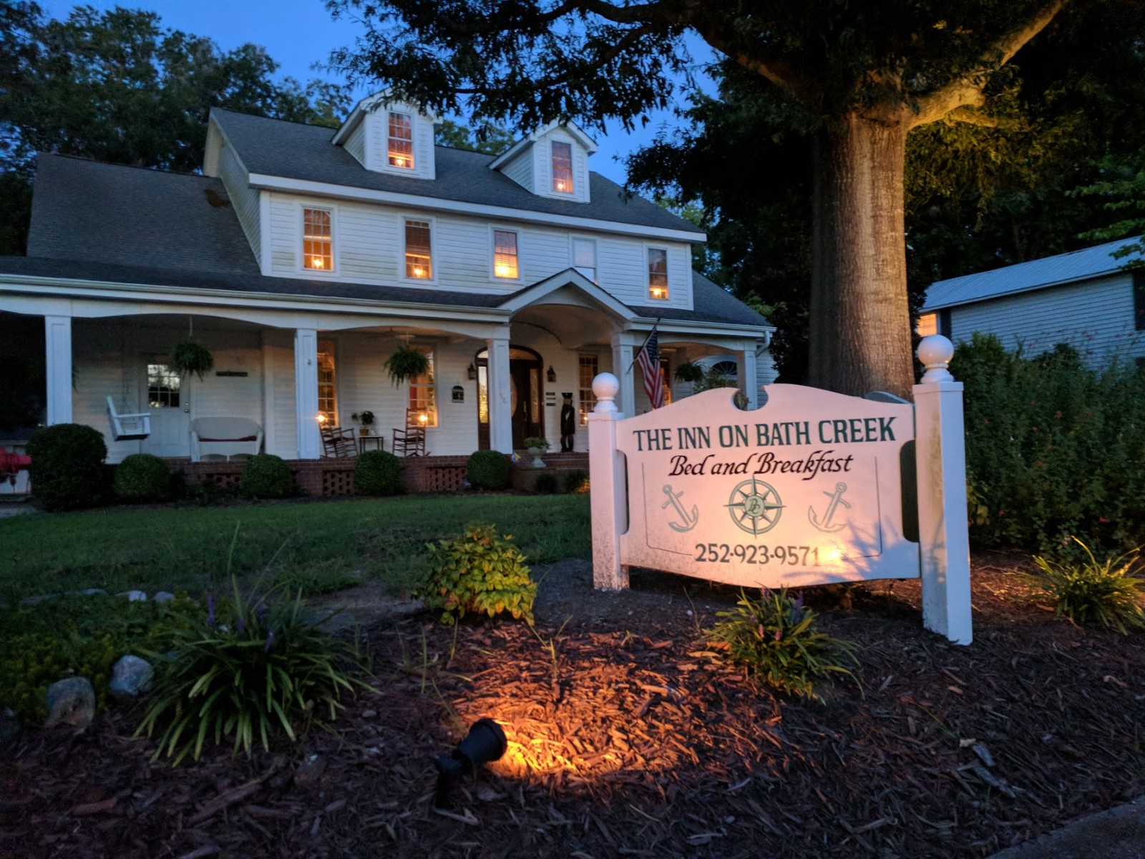
Bed And Breakfast (B&B)
A type of accommodation that offers overnight lodging and breakfast to guests.
A smaller establishment compared to hotels which provides a more personalised experience.
The key characteristic of a bed and breakfast is the personal touch and warm hospitality provided by the hosts.
B&B owners often reside on the premises and personally interact with guests, offering a more intimate and homely experience.

Slide 6


COZY
According to a survey, approximately 25% of travelers prefer staying at bed and breakfast accommodations for their unique charm, personalized service, and local experiences.
RELAXED
UNIQUE CHARMS OF B&B
PERSONALISED
CULTURE
INTIMATE

Slide 7

PARTNERSHIP ASSESSMENT
Our partnership combines the strengths of our hotel chain and a select group of exceptional bed and breakfasts.
Together, we aim to deliver outstanding guest experiences and maximize our market potential.
With shared values and a commitment to excellence, this collaboration creates a seamless and harmonious stay for our guests, blending personalized service with the charm of local accommodations.

Slide 8






KEY CONSIDERATIONS
Strategic Alignment
Assess the strategic goal of both the parties and Evaluate the potential for enhancing customer experience and market position.
Target Market and Customer Synergy
Evaluate the compatibility of target markets and customer base.
Identify the cross-promotion and Marketing Opportunities.
Operational Integration
Access the compatibility of operational systems of both
the parties.
Financial Viability
Conduct the financial analysis of Bed and Breakfast to ensure the Financial Stability

Slide 9





KEY CONSIDERATIONS
Analyse the loactions of various B&Bs to find the best possible areas to stay in.
Location and Accessibility
Ensure that the B&Bs meet the standards of the Hotel while preserving its unique Experience.
Quality Standards
Potential Risks
Access the complication assoicated with the partnership
Establish clear finacial reporting and accountability mechanism.
Reporting

Slide 10

OUR
RECOMMENDATION
STRATEGIC PARTNERSHIP

Slide 11


Investment Estimation
Return on Investment
Evaluate bed and breakfast's current state, identify improvements and costs while preserving its charm.
04
Negotiation and Agreement
Evaluate bed and breakfast, identify improvements and costs while preserving charm.
03
Market Research
Negotiate investment with bed and breakfast owners, considering finances and revenue sharing.
02
Evaluation of Bed and Breakfast
Evaluate ROI to justify investment based on revenue, market share, customer satisfaction, and brand reputation.
01

Slide 12




ROLE OF THE HOTEL
EXPOSURE ON HOTEL PLATFORM
REWARDS PROGRAM
CROSS PROMOTION
Features the Bed and breakfast on the Hotel's official website
Incorporate the Hotel's Rewards programs with the B&B to encourage customer loyalty
Promoting the brand through various maketing channels for mutual benefits

Slide 13


ROLE OF THE HOTEL
MARKETING SUPPORT
SUPPLIER CONTACTS
TRAINING
Collaboration in joint marketing campaigns, events and social media platforms
Provide assistance to enhance operational efficiency and overall customer experience
Sharing supplier network for better pricing and quality products

Slide 14

BENEFITS OF PARTNERSHIP
INCREASED BRAND VISIBILITY
BETTER REWARDS PROGRAM
CUSTOMER STATISFACTION
Expand the presence of both brands and widen the customer base
Increase in booking and revenue along with increase in popularity of the program
Offer the guest oppurtunity to experience a more relaxed & personlised stay
INCREASED MARKET SHARE
INSIGHTS FOR FUTURE PROSPECTS
GOODWILL
The partnership would increase the market share of the hotel by tapping into untapped market.
Gain customer data from different regions and strategically evaluate the expansion of our hotel chain
Showcasing the hotel's dedication to quality lodging and community support.

Slide 15




MARKETING AND BRANDING
JOINT MARKETING CAMPAIGN
TARGET AUDIENCE
CROSS PROMOTION OF BOTH PARTIES
LOCAL PARTNERSHIPS
Collaborating online and offline to boost our presence and bookings.
Ideal for tourists, extended stays, romantic getaways, local experiences, and budget-conscious seekers.
To effectively promote your brand and boost bookings
Collaborate with local businesses to curate an immersive and genuine local experience.

Slide 16

AN EDGE OVER
OUR COMPETITORS
By combining unique accommodations, integrated loyalty programs, and an innovative customer focus, we differentiate ourselves from competitors in the industry.
With a strong emphasis on personalized experiences, attentive service, and meticulous attention to detail, we create memorable stays that exceed customer expectations.

Slide 17
7S Framework
Application
Strategy
Structure
By leveraging this framework, we optimize the project's elements to drive cohesion, efficiency, and success.
Style
System
Shared Values
Staff
Skills

Slide 18



GUESSTIMATE
Problem Statement : Profit Share (revenue) of the hotel chain from One Coastal region located B&B and One Mountainous region located B&B in a year respectively.
After Assessment of Several Factors, we recommend that the Hotel Chain to demand 40% share of the Bookings done through the Hotel's Platform and 15% share of the Bookings done through the other Platforms.
The total revenue that the hotel can generate by partnering with one B&B in the Coastal region in one year will be approximately = 3,00,729 Rs
The total revenue that the hotel can generate by partnering with one B&B in the Mountainous region in one year will be approximately = 2,77,686 Rs

Slide 19

FUTURE
PROSPECTS
Expansion into New Markets
Continued Collaboration and Communication
Technological Advancements
Development of New Offerings
Sustainable Practices
Strategic Alliances and Collaborations
Consumer Demands Adaptation

Slide 20


CONCLUSION
A strategic partnership with B&B is strongly recommended by us.
It offers operational integration, effective marketing, and growth prospects to redefine the hospitality industry and create unique guest experiences.

Slide 21



THANK YOU

